Slide 1
Infrastructure as a Service
Notes:
Introduction to the Cloud

Slide 2
Overview
Virtual Machines
Instance Types
Automation
Virtual Machine Pools
Storage
Network
Firewalling
Network Load Balancers
VPNs, private interconnects, and routing services
DNS
Monitoring
Notes:
Infrastructure as a Service, or IaaS is a service offering by most cloud providers that provides virtual machines and the accompanying infrastructure as a service. This lecture will discuss the details of how an IaaS service is built.

Slide 3
Virtual Machines
Source: Unsplash/chuttersnap under Unsplash License

Slide 4
IBM System/370
| Source: Wikipedia/Oliver.obi under CC BY-SA 3.0
Notes:
Virtualization is a surprisingly old technology. The first virtualized system was the IBM System/370 mainframe with the VM/370 operating system in 1972. The system was different from how we understand virtualization today, but the goal was the same: separate workloads from each other.
When you think about mainframes you have to consider that these machines were very expensive and machine time was a scarce resource. Most programs back in those days were batch jobs. They processed a large set of data at once and then terminated.
Initially CPUs in personal computers did not have application separation.

Slide 5
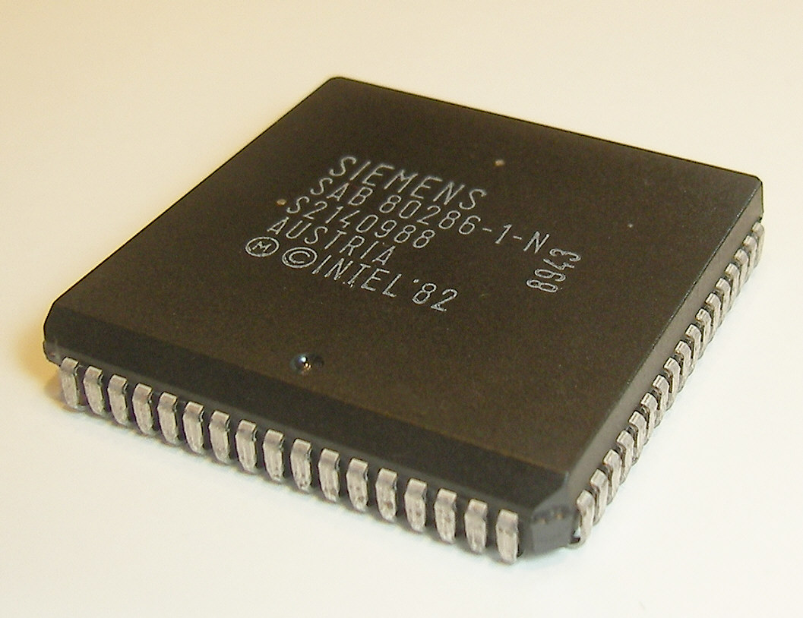
Intel 80286
| Source: Wikipedia/Peter Binter under Public Domain
Notes:
The x86 line of Intel CPUs only received the protected mode feature with the 80286 in 1982. The operating system (MS/DOS) would run in in real mode and applications could then switch into the new mode to isolate applications from each other. One such application making use of the new mode was Windows that ran on top of MS/DOS.

Slide 6
CPU rings
Applications
Device Drivers
Device Drivers
Kernel
Ring 0
Ring 1
Ring 2
Ring 3
Notes:
Protected mode introduced the concept of rings in the CPU. The operating system kernel would run in ring 0, device drivers would run in ring 1 and 2 while applications would run in ring 3. The lower ring number meant the higher privilege level.
Note: Device drivers today typically run on ring 0 instead of 1 or 2.
This ring system allowed the operating system to restrict the higher ring numbers from accessing certain functions or memory locations. However, most applications in the day would violate the restrictions of protected mode and could not run in the new mode.

Slide 7
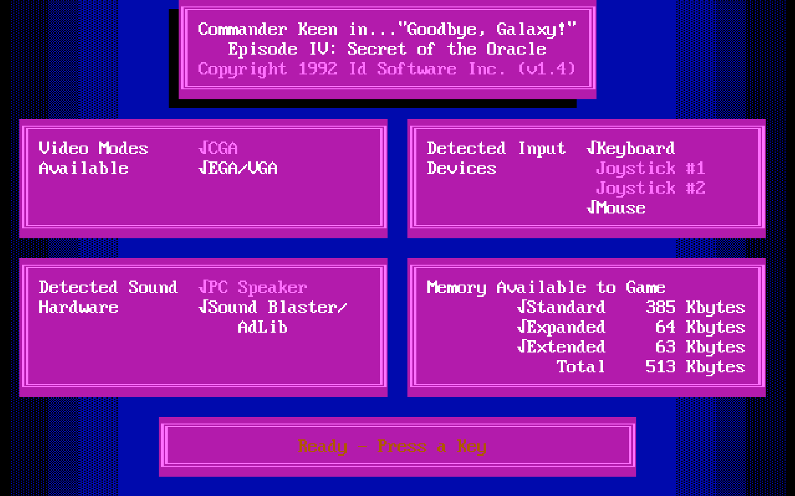
Old games…
| Source: Commander Keen 4 by ID Software
Notes:
Note: If you try and set up a really old computer game like Commander Keen in DOSBox you will realize that you have to provide the game itself with very hardware-specific settings. You will, for example, have to provide details for your sound card. This is because the game itself incorporated sound card drivers for Sound Blaster 16 or Gravis Ultrasound cards. A game that would do this could not run in protected mode.

Slide 8
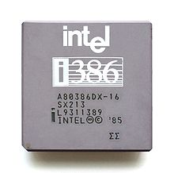
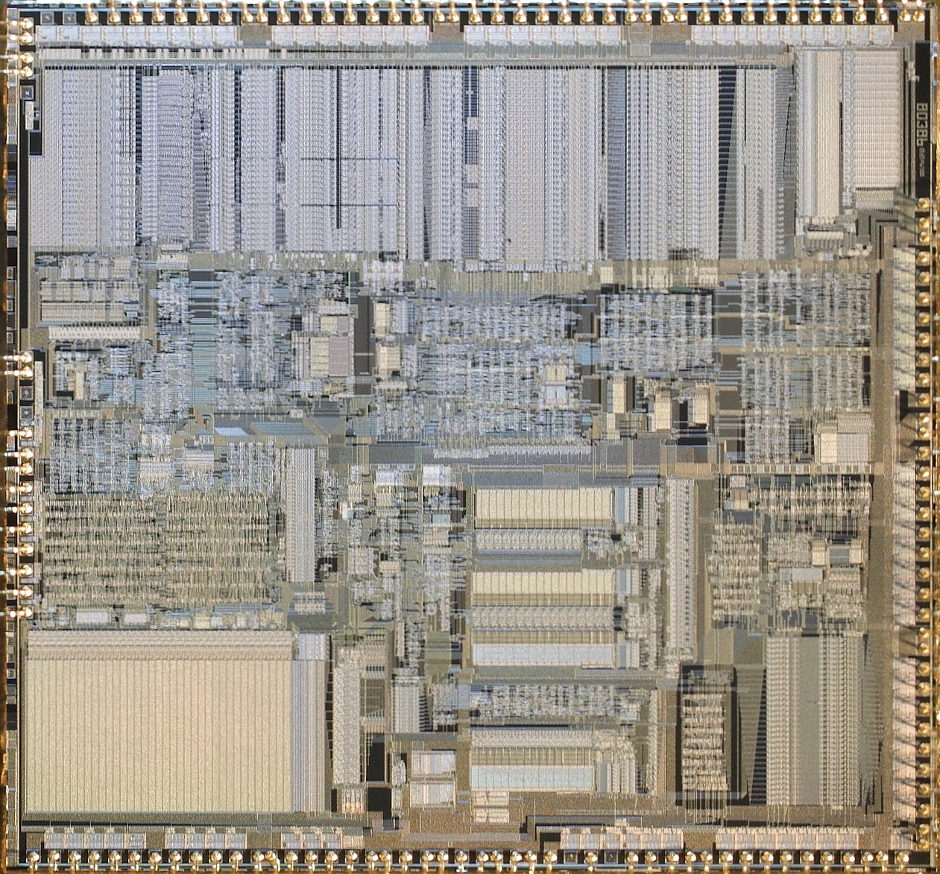
Intel 80386
| Source: Wikipedia/Pdesousa359 under CC BY 3.0
Notes:
To work around the problems with protected mode the 80386 successor introduced virtual mode. The new virtual 8086 mode (VM86) introduced a number of compatibility fixes to enable running old real mode programs in a multitasking environment such as Windows without problems.
For instance the CPU would create a simulated virtual memory space the program could write to and translate the virtual addresses to physical addresses internally. It would also capture sensitive instructions and turn them over for control to the kernel.
Note: VM86 does not capture every instruction the application runs in virtual mode, only the sensitive CPU instructions. This enables legacy applications to run at a reasonable speed.

Slide 9
(Para)virtualization
Applications
Guest Kernel
Applications
Host Kernel
Hardware
| Source: Wikipedia/Pdesousa359 under CC BY 3.0
Notes:
In the mid 2000's CPUs became so powerful that it made sense to not only virtualize applications but whole operating systems including their kernel. This allowed multiple operating systems to run in parallel. However, without CPU support only software virtualization could be achieved. In other words early virtualization software had to simulate a CPU in ring 0 to the guest operating system. Some virtualization techniques, such as Xen required the guest operating system to run a modified kernel to facilitate them running in ring 3. Others employed a number of techniques we won't go into here.

Slide 10
CPU rings (virtualization)
Applications
Device Drivers
Device Drivers
Kernel
Ring -1
Ring 0
Ring 1
Ring 2
Ring 3
Notes:
Hardware vendors, of course, followed suit. In 2005 Intel added the VT-x (Vanderpool) feature to its new Pentium 4 CPUs followed by AMDs SVM/AMD-V technology in 2006 in the Athlon 64, Athlon 64 X2, and Athlon 64 FX processors.
VT-x and AMD-V added new ring -1 to accommodate hypervisors. This new ring allowed for separation between several operating systems running at ring 0. Later CPU releases added features such as Direct Input/Output virtualization, network virtualization or even graphics card virtualization. These features allowed for more efficient virtualization and sharing hardware devices between several virtual machines.

Slide 11
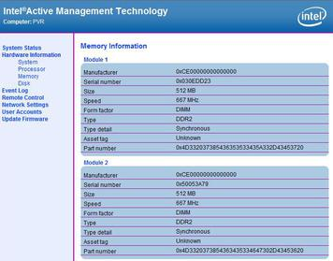
Intel ME
| Source: Wikipedia under Proprietary License
Notes:
Note: Intel also introduced a ring -2 for the Intel Management Engine, a chip that functions as an OOBM in modern Intel chips. The ME runs its own operating system, a MINIX variant and has been the target of severe criticism for its secrecy and power over the machine. Several bugs have been found in the ME that let an attacker hide a malware inside the ME.

Slide 12
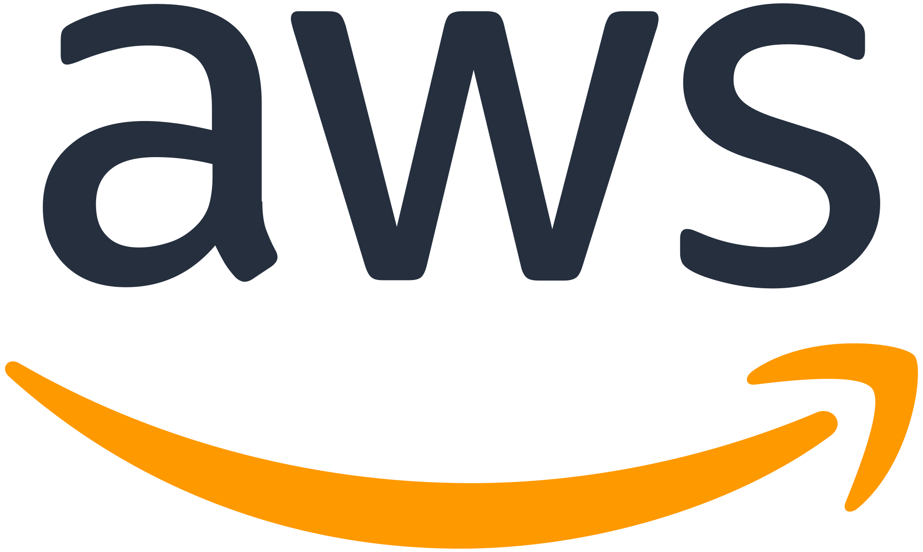
Cloud
| Source: Amazon Web Services
Notes:
Virtualization also gave rise to Infrastructure as a Service. AWS was the first service that offered virtual machines as a service starting in 2006 with a Xen-based offer. They not only offered virtual machines but they did so that a customer could order or cancel the service using an Application Programming Interface.
This allowed customers to create virtual machines as they needed it and they were billed for it on an hourly basis. (Later on AWS and other cloud providers moved to a per-second billing.)
The presence of an API makes the difference between IaaS and plain old virtual machines as a service. IaaS allows a customer to scale their application dynamically according to their current demand.

Slide 13
Typical Instance Types
Source: Unsplash/Kelvin Yup under Unsplash License

Slide 14
Instance sizes
Shared CPU: small, balanced, burstable
Dedicated core: medium-large, balancer, not burstable
High CPU: lots of CPU, little RAM
High RAM: lots of RAM, little CPU
Storage: little CPU, little RAM, local storage
Hardware-specific: access to GPU or FPGAs
| Source: Amazon Web Services
Notes:
When the cloud became popular in the late 2000s several providers attempted to offer a service that was fully dynamic in their sizes. The customer could set how many GB of RAM they needed and how many CPU cores. However, this model has been phased out by most providers since it is difficult to manage such a dynamic environment.
Instead most cloud providers nowadays opt to offer fixed machine sizes. To accommodate high-CPU and high RAM workloads there are several different instance types, typically:
Shared CPU: These are small instances where a single CPU core is shared between multiple virtual machines, sometimes leading to high steal time. Sometimes this offering includes a burst capability (such as the Amazon T instances) where a VM can temporarily use more CPU.
Standard, dedicated core CPU: These instance types receive one or more physical cores leading to a more stable performance without the ability to burst beyond their limits.
High CPU: These instance types are usually hosted on physical servers that have a very high CPU to RAM ratio. Accordingly, the virtual machine offering includes more CPU than the standard offering.
High RAM: This offering is the exact opposite of the high CPU offering. The machines on offer here include more RAM with very little CPU.
Storage: These instance types contain large amounts of local storage (see below in the storage section).
Hardware-specific: These instance types offer access to dedicated hardware such as graphics cards (GPUs) or FPGAs.

Slide 15
Automation
Source: Unsplash/Photos Hobby under Unsplash License

Slide 16
APIs
Cloud
Automation tool
Notes:
As discussed before, what makes an IaaS cloud provider a cloud provider is the fact that they offer an API to automate the provisioning and deprovisioning of virtual machines as needed. However, that's not all. Simply starting a virtual machine is not enough, the software needs to be installed in it.
Initially this problem would be solved by creating templates for the operating system that launches. In larger cloud setups these templates included a pre-installed agent for configuration management that would report to a central service and fetch its manifest of software to install.

Slide 17
User Data / Cloud Init
Cloud
Metadata API
Provides
Create
Create
Fetch
Automation tool
Virtual Machine
Cloud Init
Notes:
Thankfully in the last decade a lot has happened and Cloud Init has established itself as a defacto standard in the IaaS world. Every cloud provider nowadays offers the ability to submit a user data field when creating a virtual machine. This user data field is read by Cloud Init (or its Windows alternative Cloudbase Init) and is executed at the first start of the virtual machine.
A DevOps engineer can simply inject a script that runs at the first start that takes care of all the installation steps required.

Slide 18
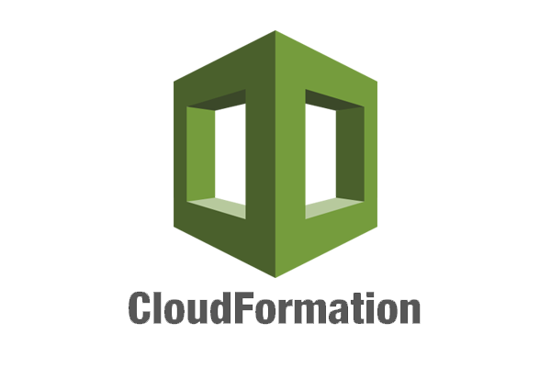
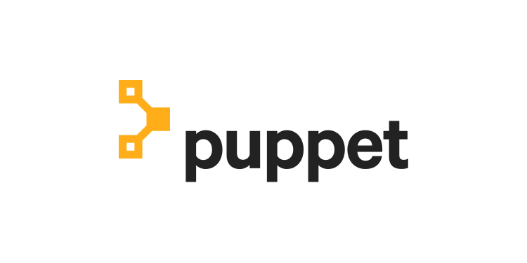
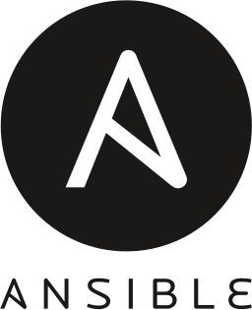
Automation Tools
Notes:
Tools like Terraform or Ansible assist with managing the whole process of provisioning the virtual machines and supplying it with the correct user data script.

Slide 19
Virtual Machine Pools
Source: Unsplash/big.tiny.belly under Unsplash License
Notes:
One other use of user data are virtual machine pools. Each cloud provider adopts a different name for them, ranging from instance pools to autoscaling groups. The concept is the same everywhere: you supply the cloud with a configuration how you would like your virtual machines to look like and the cloud will take care that the given number of machines are always running. If a machine crashes or fails a health check the cloud deletes the machine and creates a new one.

Slide 20
Virtual Machine Pools
Load Balancer
VM
VM
VM
VM
VM
Notes:
The number of machines in a pool can, of course, be changed either manually or in some cases automatically using rules for automatic scaling.
Combined with the aforementioned user data this can be a very powerful tool to create a dynamically sized pool of machines and is the prime choice for creating a scalable architecture.
These pools are often integrated with the various load-balancer offerings cloud providers have in their portfolio to direct traffic to the dynamic number of instances. Some cloud providers integrate them with their Functions as a Service offering as well allowing you to run a custom function whenever a machine starts or stops. This can be used to, for example, update your own service discovery database.

Slide 21
Storage
Source: Unsplash/Ruchindra Gunasekara under Unsplash License

Slide 22
Disks
VM
VM
VM
VM
VM
Disk
Disk
Disk
Disk
Disk
Notes:
When it comes to data storage virtual machines work exactly like your physical machine would: there is a physical disk (or multiple) that store the files. The difference is that in the cloud your virtual machine may make use of a distributed storage architecture instead of using a local disk. In a distributed storage system the data isn't stored on the machine that runs the virtual machine so a hardware failure on that machine will not cause a data loss.
However, a distributed storage system is generally either slower or more expensive for the same performance by several magnitudes so using a local storage may still be needed for some use cases.

Slide 23
Disks
Filesystem
hello.txt
Notes:
When we talk about storage systems we are talking about two types: block devices and filesystems. On the physical disk data is stored in its raw form so the disk itself has no information about which data belongs to which file. Filesystems organize data into blocks of a fixed or dynamic size and then create a database (mapping table) of which file entry consists of which blocks of data. Keep in mind that the blocks of a single file may be distributed all over the whole disk randomly so that's something the filesystem must keep track of.
Therefore we traditionally call raw disk devices block devices. Block devices are (with very few exceptions) only accessible from a single virtual or physical machine since otherwise the machines would have to synchronize their file system operations on that device. The only notable exception is GFS2. While you can use GFS2 over a shared storage infrastructure if you have control over it cloud providers enforce a single-VM access policy. In other words, one block storage device can only ever be used by a single VM.

Slide 24
Local Disks
VM
VM
Disk
Disk
Disk
Notes:
As described above the simplest and most widely supported option to store data from your virtual machine is a disk that is locally attached to the physical machine running the VM. This option offers you the highest performance at a relatively low price point. The reason for that is that it is the simplest and cheapest to build.
Some cloud providers offer disk redundancy (RAID) while others don't. At any rate a hardware failure of the physical machine means that your data may become unavailable for a period of time or may be completely lost.
It is therefore very advisable to solve redundancy on top of the virtual machine, e.g. by building a replicated database setup. If, however, your database is replicated anyway you may no longer need the more expensive storage options and this can be a great way to save costs.

Slide 25
Network Block Storage
VM
VM
Disk
Disk
Disk
Notes:
Network block storage means a block storage that is delivered over the network. The network here can mean a traditional IP network or a dedicated Fibre Channel infrastructure.
As described before block storage is, in general, single-VM only. You can't access the files stored on a block storage device from multiple virtual machines.
Also note that Network Block Storage does not automatically come with redundancy. Some solutions, such as iSCSI simply offer the disk of one machine to another. More advanced ones like Ceph RBD or the cloud provider offerings such as EBS by Amazon, however, do offer redundancy.
At any rate, using Network Block Storage does not absolve you from the duty to make backups and have a documented and tested disaster recovery strategy.

Slide 26
Network File System
VM
VM
VM
Network File System
Disk
Disk
Disk
Notes:
In contrast to network block storage network file systems offer access to data not on a block level, but on a file level. Over the various network file system protocols machines using these file systems can open, read and write files, and even place locks on them.
The filesystem has to keep track of which machine has which file open, or has locks on which file. When multiple machines edit the same file in parallel the filesystem has to ensure that these writes are consistent. This means that network file systems are either much slower than block-level access (e.g. NFS) or require a great deal more CPU and RAM to keep track of the changes across the network (e.g. CephFS). Some cloud providers also offer this, for example Amazon's EFS.

Slide 27
Object Storage
Object Storage
VM
VM
VM
Notes:
Object storage systems are similar to network file systems in that they deal with files rather than blocks. However, they do not have the same synchronization capabilities as network file systems. Files can generally only be read or written as a whole and they also don't have the ability to lock a file.
While object storages technically can be used as a filesystem on an operating system level for example by using s3fs this is almost always a bad idea due to the exceptionally bad performance and stability issues.
Operating system level integration should only be used as a last resort and object storages should be integrated on the application level. We will discuss object storage services in detail in our next lesson.

Slide 28
Network
Source: Unsplash/Thomas Jensen under Unsplash License
Notes:
The next big topic concerning IaaS services is networks. Before we go into the cloud-aspect let's look at how the underlying infrastructure is built. As indicated in the first lecture it is strongly recommended that you familiarize yourself with the basics of computer networking, such as the Ethernet, IP and TCP protocols as you will need them to understand this section.

Slide 29
Cloud Network
ToR Switch
ToR Switch
ToR Switch
ToR Switch
ToR Switch
Server
Server
Server
Server
Server
Server
Server
Server
Server
Server
Server
Server
Server
Server
Server
Router
Server
Server
Server
Server
Server
Internet
Notes:
So, let's get started. Imagine a data center from the first lecture. Your task is to build an IaaS cloud provider. You put your servers that will serve as your hosts for virtual machines in the racks. These servers will be connected to the Top-of-Rack switches (yes, two for redundancy) using 10 GBit/s network cables. The switches are themselves connected among each other and across racks with several 100 GBit/s.
This sounds like a lot of bandwidth available but keep in mind that your virtual machines get assigned to the physical machines as capacity allows. There is no cloud provider that can guarantee the bandwidth or latency between two virtual machines. Generally cloud providers only state the theoretical bandwidth of the connection a virtual machine has to the switching fabric, but not the specific bandwidth between two distinct virtual machines.
This is part of the reason why in the cloud scaling horizontally (adding more machines) is preferred rather than creating huge instances with lots of resources.

Slide 30
Private-only network with NAT
Internet
NAT Gateway
Provider-operated
Network Address Translation
VPC
VM
VM
Notes:
Private-only network with NAT: This option is provided by the larger cloud providers such as AWS, Azure, GCP and IBM. This setup gives each virtual machine a private IP address on a private network only. When a public IP address is needed that public IP is handled by the gateway provided by the cloud provider and the incoming traffic is forwarded to the virtual machine on the private network using Destination NAT. Multiple private networks (VPC's) can be assigned to a virtual machine and they can work independently.

Slide 31
Default Public IP
Public Network
Internet
VM
VM
Private Network
Notes:
Default public IP: This option is provided by smaller IaaS providers such as DigitalOcean, Exoscale, Hetzner, Linode, Upcloud, and Vultr. In this setup each virtual machine is attached to a public network and is directly assigned one public IP address. Optionally private networks can be attached as well but the first public IP generally cannot be removed as it is required for user data to work.

Slide 32
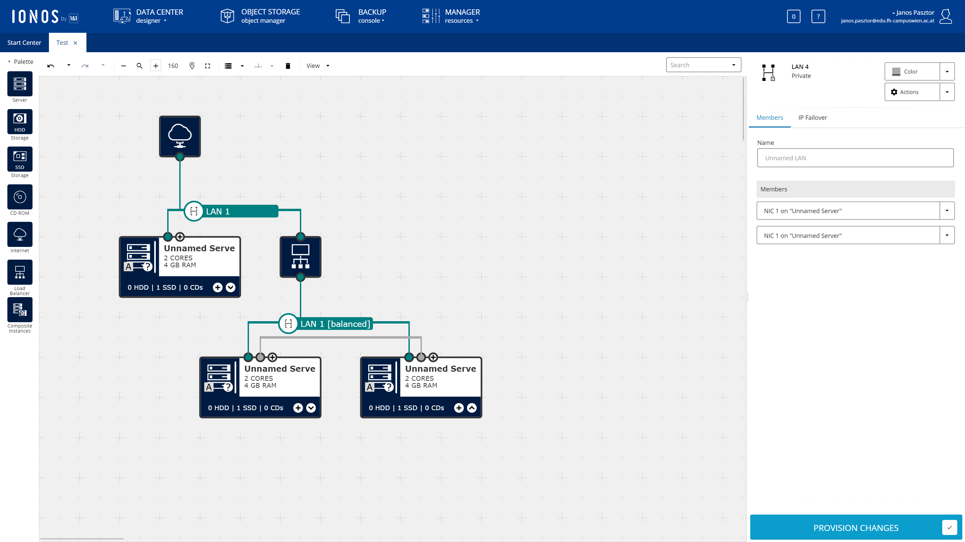
Fully Customizable
Notes:
Fully customizable: This setup allows the customer to design their network connectivity as they see fit. This setup is suitable for enterprise customers who want to move their on-premises setup into the cloud without changing their architecture (lift-and-shift). This option is offered by 1&1 IONOS.
Note: There are several other cloud providers which we have no information on, such as the Deutsche Telekom/Open Telekom Cloud, or the Alibaba Cloud. You can classify any cloud provider you come across into these categories.
Note: Out of group 2 it is worth mentioning that the services that are available on the public network (firewalls, load balancers) are often not available on private networks.

Slide 33
Firewalling
Source: Unsplash/Viktor Forgacs under Unsplash License
Notes:
IaaS providers often also offer network firewalls as a service, included in the platform. Firewalls generally have two rule types: INGRESS (from the Internet or other machines to the current VM) and EGRESS (from the current VM to everywhere else).

Slide 34
Security Groups
VM
VM
Notes:
Firewall providers often employ the concept of security groups. The implementation varies greatly, but in general security groups are a reusable set of rules that can be applied to a VM.
For most cloud providers you will need to create an explicit rule allowing traffic to flow between two machines in the same security group.

Slide 35
Security Groups
appserver
database
Notes:
The advantage of security groups is that the rules can be made in such a way that they reference other security groups rather than specific IP addresses. For example, the database security group could be set to allow connections only from the appserver security group but not from anywhere else. This can help with the dynamic nature of the cloud since you do not need to hard-code the IP addresses of the application servers.

Slide 36
Network Load Balancers
Source: Unsplash/Jani Brumat under Unsplash License
Notes:
Network load balancers are an option some cloud providers offer. In contrast to Application Load Balancers they do not offer protocol decoding (such as routing requests to backends based on the requested web address), they only balance incoming connections to a pool of backends.

Slide 37
Network Load Balancer
Network Load Balancer
VM
VM
Notes:
Depending on the cloud provider in question network load balancers may or may not offer terminating encrypted connections (SSL/TLS), and may be bound to virtual machine pools. It is also cloud provider specific if load balancers are offered in private networks or not.
When designing an architecture it is worth considering if the real IP address of the connecting client will be needed. If the backend needs to know the real IP address of the client and the network load balancer handles SSL/TLS termination that combination may not be suitable for the task unless a specific trick such as the proxy protocol from Digital Ocean. Network load balancers without SSL/TLS termination should, in general, make the client IP available to the backends.
In order to make sure requests are not sent to faulty backends NLBs include a health check feature. This health check either simply opens a connection to the respective backends (TCP check) or requests a webpage from the backend (HTTP check). If the check fails the backend is removed from the rotation. When integrated with virtual machine pools they may automatically shut down and replace the faulty machine, but this is often not the case. It is on the operator to destroy faulty machines.
When talking about load balancers an interesting question is the load balancing strategy. Most load balancers support either round robin (selecting the next backend in the list) or source hashing (routing the same connecting IP to the same backend).

Slide 38
VPNs, interconnects, routing
Source: Unsplash/Fabio Bracht under Unsplash License
Notes:
While it seems convenient at first to use only the public network several organizations have security models that prevent accidental public exposure of services not only by implementing the appropriate firewalls (e.g. with security groups) but also by not having private services on the public internet at all. To connect these internal services you must be on a private network.

Slide 39
Goal
VM
VM
Cloud
On-Premises
Notes:
However, this presents a problem when moving data between several, geographically distributed locations. Most companies don't own continent-spanning fiber channel backbones where they could simply create a private network without going on the internet. This means that most companies have to choose one of two methods if they want to create a private connectivity between locations (and the cloud): an MPLS tunnel or VPN.

Slide 40
MPLS
VM
Router
Provider Operated
Router
VM
MPLS
Cloud
On-Premises
Notes:
MPLS tunnels create a virtual connectivity that does not go on the Internet. While being expensive and slow to set up, it can offer a guaranteed bandwidth, latency and better security than a VPN.

Slide 41
VPN
VM
VPN Gateway
Provider Operated
VPN Gateway
VM
Cloud
On-Premises
Notes:
VPN's on the other hand create a virtual connectivity by sending data over the Internet in an encrypted form. Bandwidth or latency cannot be guaranteed, and there are several drawbacks (such as decreased MTU) but it's a very affordable solution.
Larger cloud providers tend to offer both options. MPLS is supported by the larger cloud providers (AWS Direct connect, Azure Express Route, or Google Cloud Interconnect) and also some smaller ones (e.g. Exoscale Private Connect).
VPN is also offered mostly by large providers (AWS VPC VPN, Azure VPN, or Google Cloud VPN). However, keep in mind that this VPN is a site-to-site VPN built on IPSec and requires a fixed IP address on your side as well. In other words you can't use this VPN to connect from your laptop to the cloud on the go. The only cloud service that offers a mobile device to cloud connectivity at the time of writing is Azure's Point-to-Site VPN.
It is also worth noting that VPN's can be used to connect cloud providers together.

Slide 42
DNS
Source: Unsplash/Dose Media under Unsplash License
Notes:
The Domain Name Service is one of the services that are all but required for building an infrastructure. It provides domain name to IP address resolution, such as pointing your domain example.com to an IP address of your servers.

Slide 43
DNS
Your Laptop
Your Provider
Cloud Provider
Notes:
There is a difference, however, between DNS services on offer. Some DNS services by cloud providers offer only simple resolution, other providers offer more advanced features. These features include being able to host the DNS service only on a private network without exposing it to the internet.

Slide 44
Failover
DNS
Primary Server
Secondary Server
Notes:
More advanced features may include automatic DNS failover. This involves running regular health checks on your services and if your primary service fails the DNS service can automatically switch to the secondary IP.

Slide 45
Geobalancing
Cloud Provider
Cloud Provider
Your Laptop
Your Provider
Other Provider
Other User
Europe
America
Notes:
There are even services that offer advanced functionality such as routing traffic to different servers based on the geographic location of the client. This can be used for advanced builds such as building a custom CDN. CDNs are discussed in the next lecture.

Slide 46
Monitoring
Source: Unsplash/Stellan Johansson under Unsplash License

Slide 47
Basic Monitoring
Cloud Provider
VM
Notes:
Some cloud providers offer includes basic monitoring, such as CPU or memory usage. Some providers are offering monitoring agents you can install on your virtual machine to get more data in the monitoring interface. With some cloud providers monitoring alerts can be integrated with virtual machine pools to provide automatic scaling, either automatically or using lambdas/FaaS, which we will talk about in the next lecture.
Often times the monitoring facilities offered by cloud providers are not sufficient for keeping an application running and more detailed systems are needed. These will be discussed in greater detail in the lecture 5.

Slide 48
Thank you!
Source: Unsplash/Wilhelm Gunkel under Unsplash License

